Slide 1
Government Dataset
Annual Seasonal Temperature Analysis

Slide 2
Introduction
Annual and seasonal mean temperature analysis is essential for understanding climate trends and their broader impact on the environment, agriculture, public health, and disaster preparedness. The annual mean temperature represents the average temperature recorded over a year, offering insights into long-term climatic shifts, while the seasonal mean temperature focuses on specific seasons, helping to identify patterns such as warming trends in summer or extreme cold events in winter. Analyzing these temperature variations is crucial in assessing the effects of climate change, predicting weather anomalies, and formulating policies for sustainable development. Rising temperatures can influence agricultural productivity, alter ecosystems, and increase the frequency of extreme weather events like heatwaves and droughts.

Slide 3
Introduction
Additionally, temperature fluctuations have direct implications for public health, as extreme conditions can lead to heat stress or cold-related illnesses. By studying annual and seasonal temperature data, researchers and policymakers can make informed decisions to mitigate climate risks, improve urban planning, and develop strategies for a sustainable and resilient future.

Slide 4
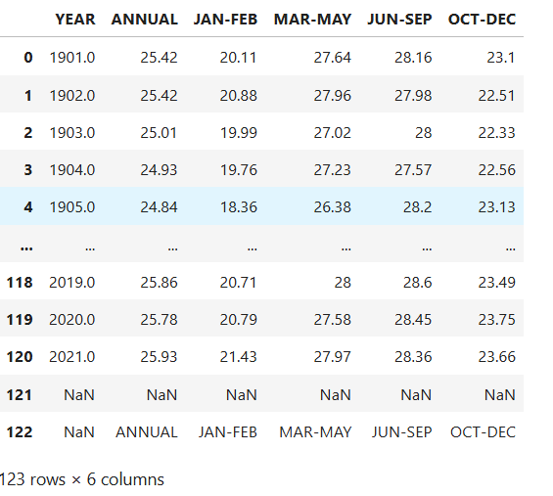
Overview

Slide 5
Column Description
1.Year - The year of recorded temperature data.
2. Annual - The annual mean temperature recorded for the given year.
3. Jan-Feb - The mean temperature recorded for the months of January and February.
4. Mar-May - The mean temperature recorded for the months of March, April, and May.
5. Jun-Sep - The mean temperature recorded for the months of June, July, August, and September.
6. Oct-Dec - The mean temperature recorded for the months of October, November, and December.

Slide 6
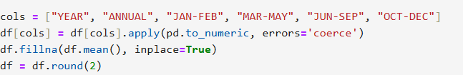
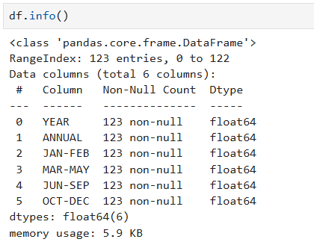
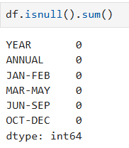
Data Cleaning

Slide 7
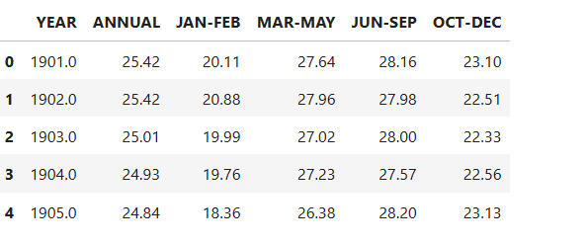
Cleaned data

Slide 8
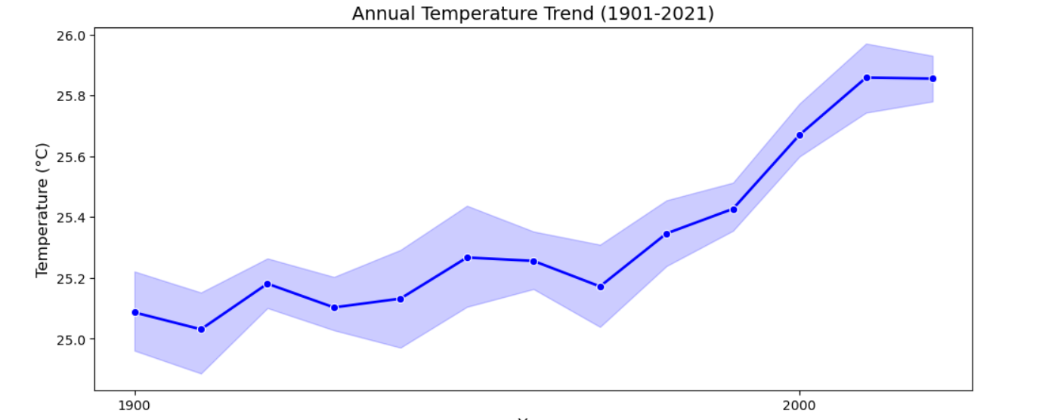
Annual Temperature trend(1901-2021)

Slide 9
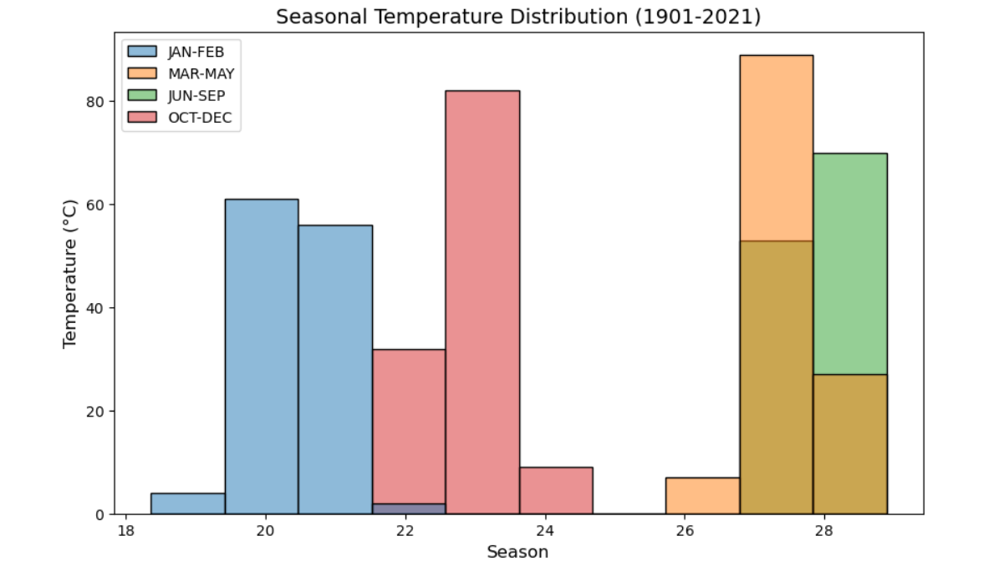
Seasonal Temperature Distribution(1901-2021)

Slide 10
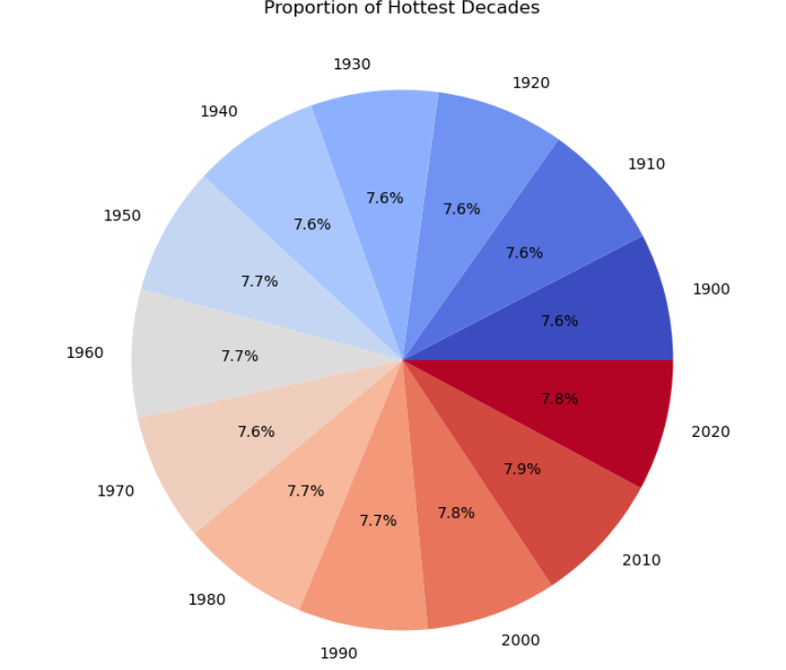
Hottest Decade

Slide 11
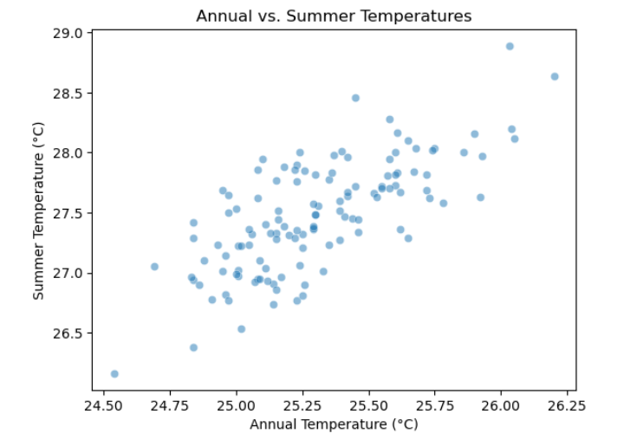
Annual vs. Summer Temperature

Slide 12
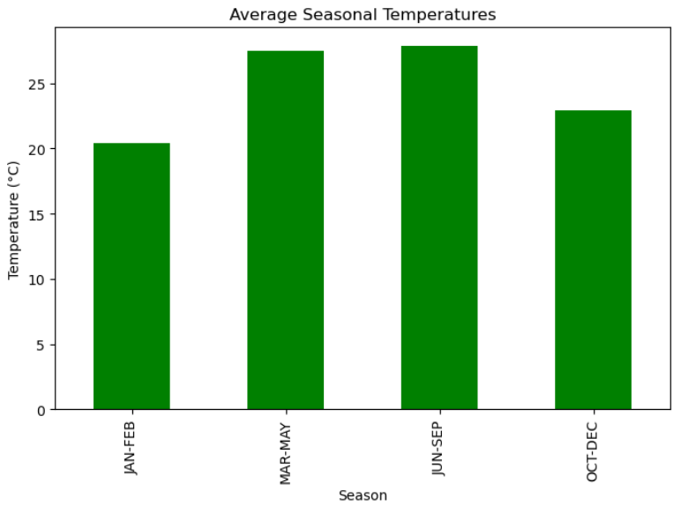
Average Seasonal Temperatures

Slide 13
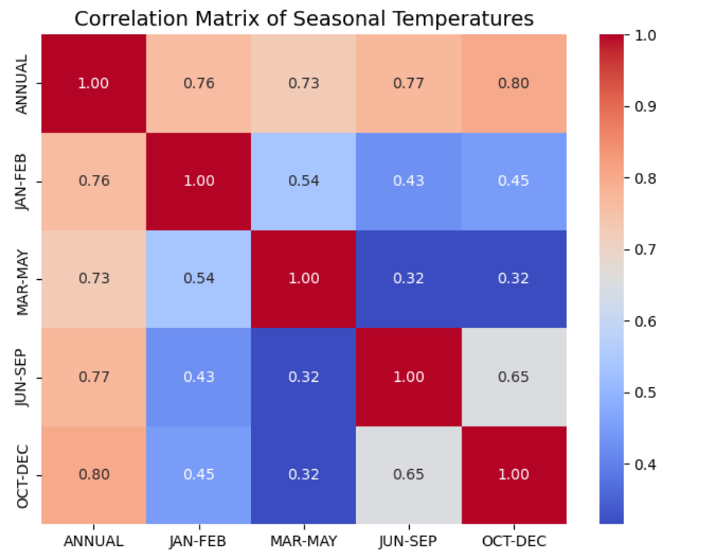
Correlation Matrix

Slide 14
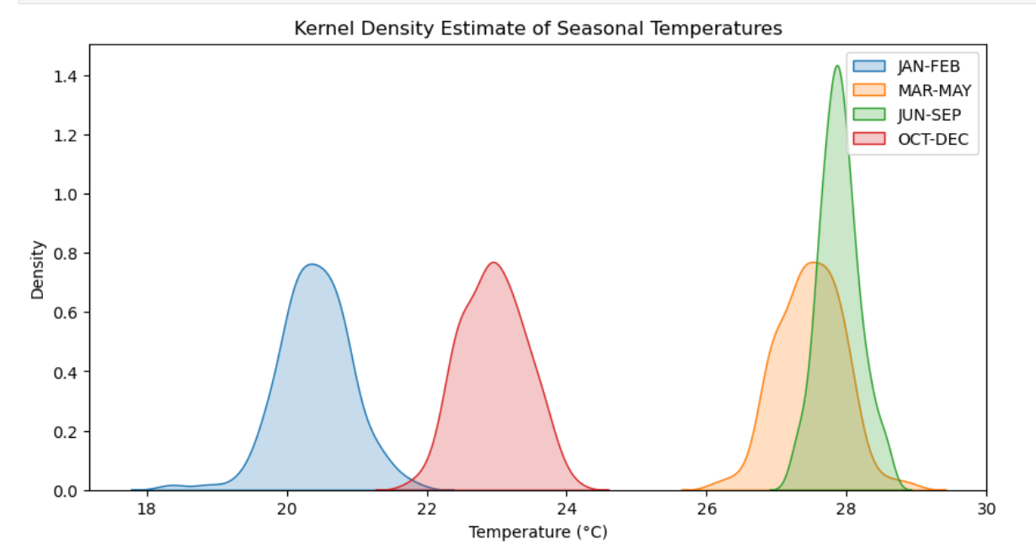
Kernel Density

Slide 15
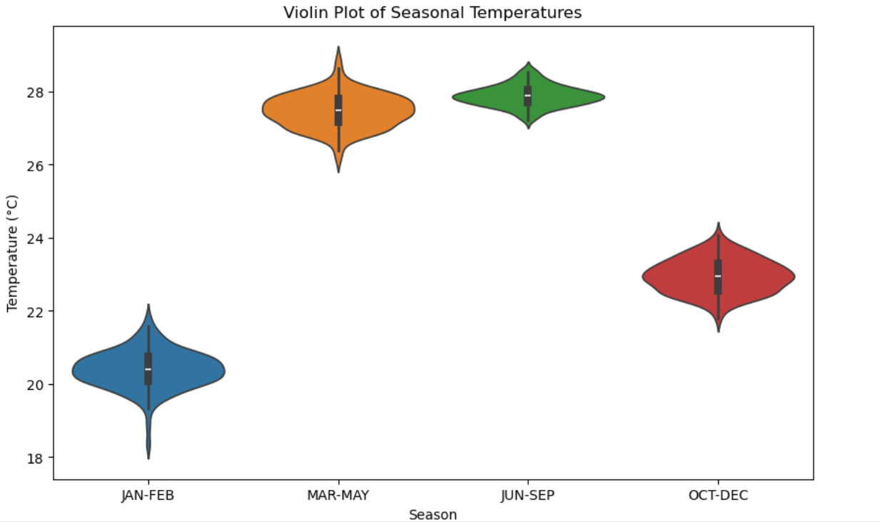
Violin Plot

Slide 16
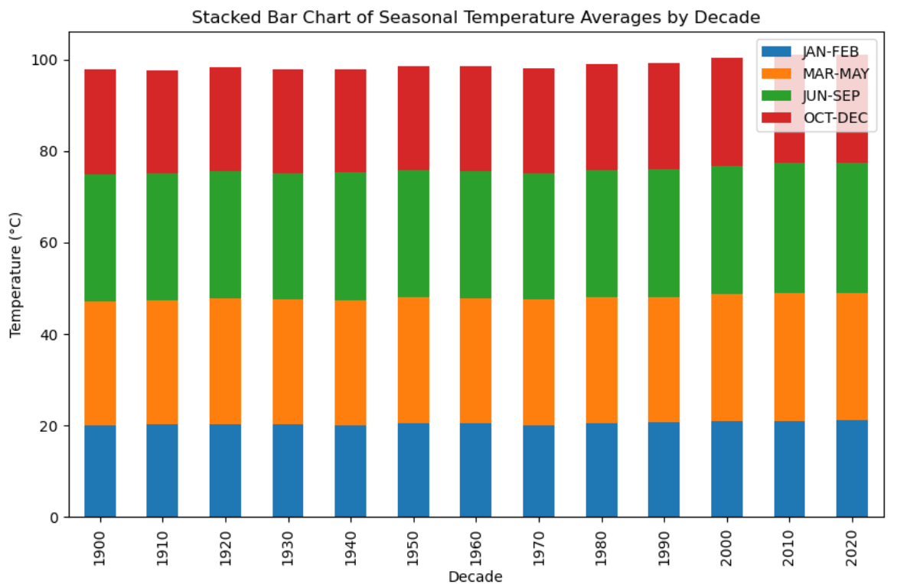
Stacked Bar Chart of Seasonal Temperature

Slide 17
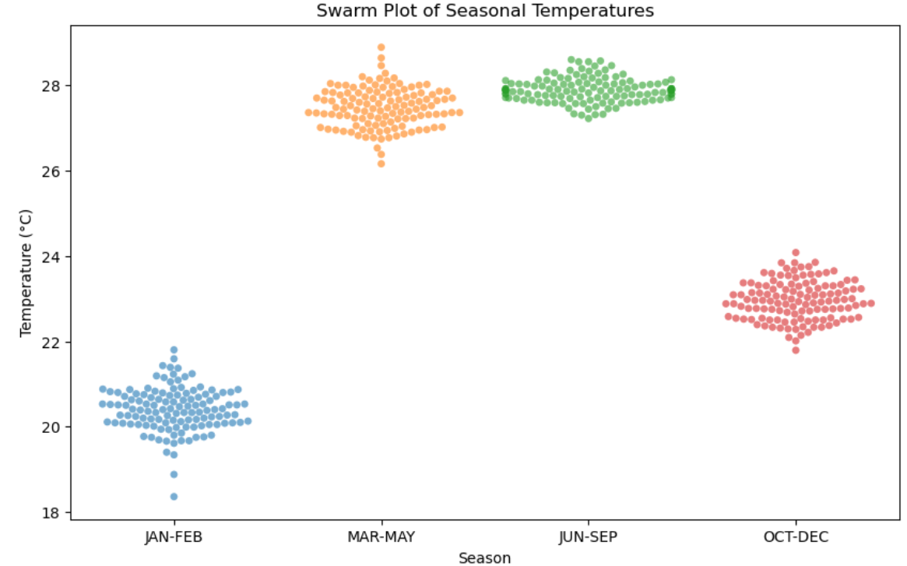
Swarm Plot of Seasonal Temperatures

Slide 18
Final Observations
Analysis of Annual and Seasonal Temperature Trends with Data CleaningThe dataset contains annual and seasonal temperature measurements across various years. We have performed data cleaning and used different visualizations to understand temperature trends and patterns.
Data Cleaning Process:Before analyzing the data, we applied the following cleaning steps to ensure accuracy and consistency:
1.Handling Missing Values:
- Converted all temperature columns to numeric format and replaced non-numeric values with NaN.
- Used the mean values of respective columns to fill in missing temperature data. - For missing YEAR values, we replaced them with the mean year value.
2. Data Type Conversion: - Converted YEAR and temperature columns (ANNUAL, JAN-FEB, MAR-MAY, JUN-SEP, OCT-DEC) to integer format for consistency.
3. Removing Duplicates: - Checked for duplicate rows and removed them if any were found.
4. Standardizing Column Names: - Ensured all column names were uniform and properly formatted for easier processing.

Slide 19
Temperature Trend Analysis
Annual Temperature Trend- A line chart visualizes the trend of annual average temperatures over time.- Helps identify whether global temperatures are rising, stable, or declining.
Decadal Temperature Changes- Instead of analyzing each year separately, we group data by decades.- This smoothens fluctuations and highlights long-term climate shifts.
Seasonal Temperature Variations- Line charts for different seasons: Winter (Jan-Feb), Summer (Mar-May), Monsoon (Jun-Sep), and Post-Monsoon (Oct-Dec).- Helps compare how temperatures in each season have changed over time.
Yearly Temperature Distribution (Boxplot)- A boxplot shows temperature variations across different decades.- Useful for detecting outliers and overall distribution changes.
Histogram of Temperature Ranges- A histogram displays the frequency of temperature values.- Helps identify common temperature ranges in the dataset

Slide 20
6. Scatter Plot of Temperature vs Year- Each point represents a year's temperature.- Helps identify clusters or anomalies in temperature trends.
7. Rolling Average Trend- A smoothed line (rolling average) reduces short-term fluctuations.- Makes long-term warming or cooling trends clearer.
8. Comparing Decades with Bar Charts- A bar chart compares average temperatures across decades.- Helps identify which decade was the warmest or coldest.
9. Correlation Heatmap- A heatmap shows relationships between different seasonal temperatures.- Helps determine if warming is consistent across all seasons.
10. Temperature Anomalies Over Time- A deviation chart shows how each year's temperature compares to a long-teights into climate trends and the impact of global warming over time.

Slide 21
THANK YOU

